Slide 1

Health vs money
-Presented by ANKIREDDYPALLI SRAVANI

Slide 2

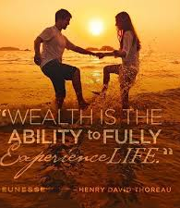
WEALTH

Slide 3
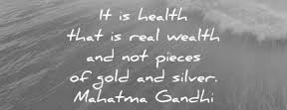
THE GREATEST WEALTH IS HEALTH

Slide 4
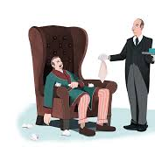

WHO IS WEALTHIER?....

Slide 5
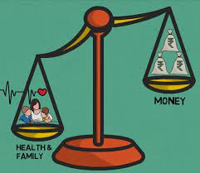
Health is more important than money

Slide 6
Here’s Why:
Health Cannot Be Bought
It Is Important To Have A Good Health To Earn Good Wealth
Health Is Important Because It Is An Important Source Of Your Happiness
Health Is Important Than Wealth Because It Stays Longevity And Happiness At All Stages Of Age
Health Is The Greatest Wealth

Slide 7
An Example
COVID-19

Slide 8




How To Maintain A Good Health?..

Slide 9
Everything can wait but health can’t. The Simple Rule is Work Hard, Earn Well, Stay Healthy, Help others and be Happy

Slide 10

References:
https://www.linkedin.com/pulse/health-more-important-than-money-marissa-fayer-mba/
https://smartechworld.in/health-vs-wealth/
https://www.quora.com/What-is-more-important-money-or-health

